Slide 1
Templates
Unit-5

Slide 2
Content
Need of template
Types of templates
Class template,
Function template,
overloading of function template
recursion with template function
class template and inheritance
difference between templates and macro

Slide 3
Templates
A template is a blueprint or formula for creating a generic class or a function.
Templates are the foundation of generic programming, which involves writing code in a way that is independent of any particular type.

Slide 4
Generic Programming
Generic programming is a technique where generic types are used as parameters in algorithms so that they can work for a variety of data types.

Slide 5
Need for templates
A template allows us to create a family of classes or family of functions to handle different data types.
Template classes and functions eliminate the code duplication of different data types and thus makes the development easier and faster.
Multiple parameters can be used in both class and function template.
Template functions can also be overloaded.
We can also use non-type arguments such as built-in or derived data types as template arguments.

Slide 6
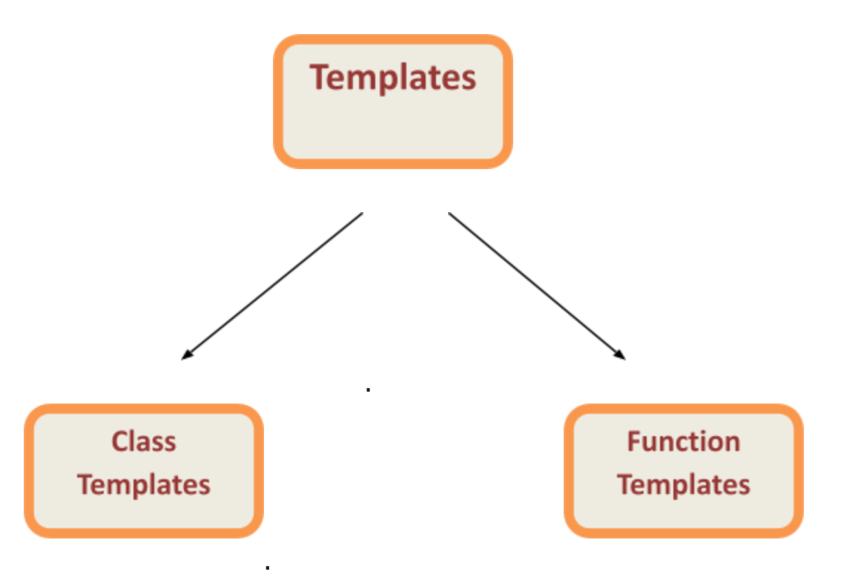
Types of templates

Slide 7
Function template
We can define a template for a function.
Generic functions use the concept of template.
a function
The type of the data that the function will define it depends up on the type of the data passed as a parameter.
It is created by using the keyword template
class or typename
Syntax:
template <class Ttype>
returnType functionName(parameterList)
{
// body of function.
}

Slide 8
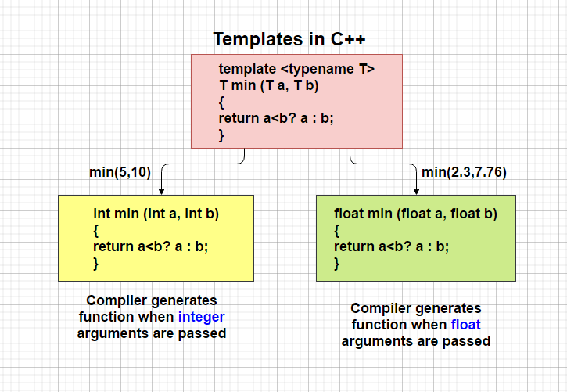
Function template
We can define a template for a function. For example, if we have an min() function, we can create versions of the min function for finding the minimum value from the int, float or double type values.

Slide 9
Example on function template
#include <iostream>
using namespace std;
template<typename T>
T mul(T a, T b)
{
return a * b;
}
int main()
{
cout<<mul(5.2,6.5);
return 0;
}

Slide 10
Which keyword can be used in template?
class
typename
both class & typename
function

Slide 11
Restrictions of Generic Functions
Generic functions perform the same operation for all the different data type.
For example If function is performing addition then it will perform addition only it will not perform subtraction, multiplication etc.…
There is the difference between function overloading and function template.

Slide 12
Class Template
A class template starts with the keyword template followed by template parameter(s) inside <> which is followed by the class declaration.
Once we've declared and defined a class template, we can create its objects in other classes or functions (such as the main() function) with the following syntax
ClassName<dataType> classObject;

Slide 13
Class template
Class template :
To create class in generic form.
Syntax
template <class type> class className
{
}

Slide 14
Example on class template
#include <iostream>
using namespace std;
template <class T>
class MCA{
public:T a,b;
T add(T x,T y)
{a=x;b=y;
return(a+b);}
};
int main(){
MCA<int>ob; cout<<ob.add(5,10)<<endl;
MCA<double>ob1;cout<<ob1.add(2.3,7.6);
}

Slide 15
What is the output of this program?
#include < iostream > #include < string > using namespace std;
template < typename T > void print_mydata(T output)
{
cout << output << endl;
}
int main()
{
double d = 5.5;
string s("Hello World"); print_mydata( d ); print_mydata( s ); return 0;
}
A. 5.5 Hello World
B. 5.5
C. Hello World
D. Error

Slide 16
Which is used to describe the function using placeholder types?
template parameters
template type parameters
template type
none of the mentioned

Slide 17
overloading of function template
Function template also can be overload
Same function name with different signature
is called function overloading and same thing we can apply for template also.
For example there is a template function for insert which take one parameter and with the same name insert we can create one more template with two parameters.

Slide 18
recursion with template function
The process in which a function call by itself is called recursion and the corresponding function is called as recursive function.
We can create recursive template function

Slide 19
How the template class is different from the normal class?
Template class generate objects of classes based on the template type
Template class saves system memory
Template class helps in making genetic classes
All of the mentioned

Slide 20
Class template and inheritance
Templates can be used to implement the concept of inheritance.
Reusability can be achieved

Slide 21
Example
#include <iostream>
using namespace std;
template<typename T>
class demo{
public: T a,b;
void show()
{
cout<<"Enter a and b value";
cin>>a>>b;
}};
template<typename T1>
class demo1 : public demo<T1>
{
public:
void display()
{
demo <int>ob;
ob.show();
cout<<ob.a<<ob.b;
}};
int main(){
demo1 <int> ob;
ob.display();
return 0;
}

Slide 22
Macros
The preprocessors statements means a instructions to the compiler to preprocess the information before actual compilation starts.
All preprocessor statement begin with #
There are number of preprocessor statements like #include,
#define, #if, #else, #line, etc.
The #define preprocessor statement creates symbolic constants. The symbolic constant is called a macro
syntax:
#define macro-name replacement-text

Slide 23
Example:
#include <iostream> using namespace std;
#define PI 3.14159 int main () {
cout << "Value of PI :" << PI << endl; return 0;
}

Slide 24
What will be the output of the following C++ code?
#include <iostream> using namespace std; int main ()
{
cout << "Value of LINE : " << LINE << endl; cout << "Value of FILE : " << FILE << endl; cout << "Value of DATE : " << DATE << endl; cout << "Value of TIME : " << TIME << endl; return 0;
}
5
details about your file
compile time error
runtime error

Slide 25
Macro
No longer
No repetition
Define in short

Slide 26
#include <iostream>
#define ks cout<<"kanika"<<endl; using namespace std;
int main()
{
kv return 0;
}

Slide 27
difference between macro and function:
MACRO | FUNCTION
Macro is Preprocessed | Function is Compiled
No Type Checking is done in Macro | Type Checking is Done in Function
Using Macro increases the code length | Using Function keeps the code length unaffected
Speed of Execution using Macro is Faster | Speed of Execution using Function is Slower
Before Compilation, macro name is replaced by macro value | During function call, transfer of control takes place
Macros are useful when small code is repeated many times | Functions are useful when large code is to be written
Macro does not check any Compile-Time Errors | Function checks Compile-Time Errors

